Slide 1
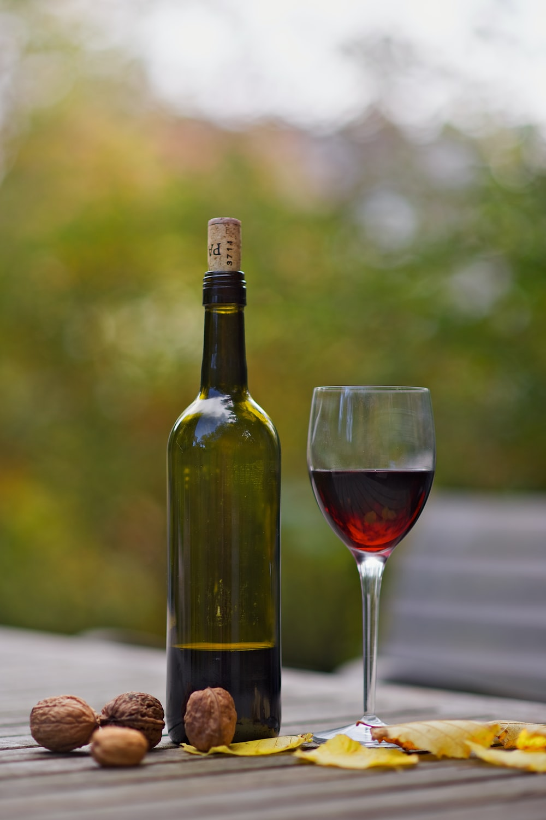
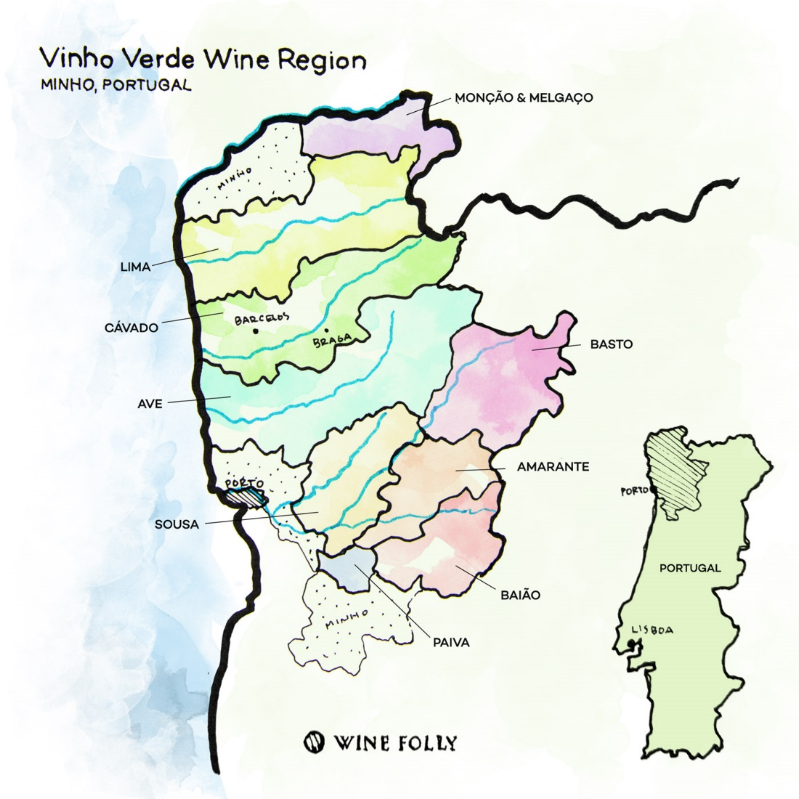
Quinta De Soalheiro: Chief Oenologist
Vinho Verde Wine Region - Portugal

Slide 2
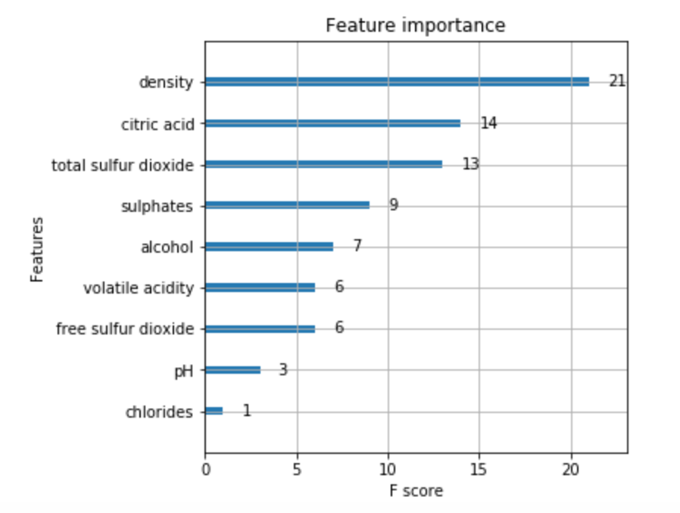
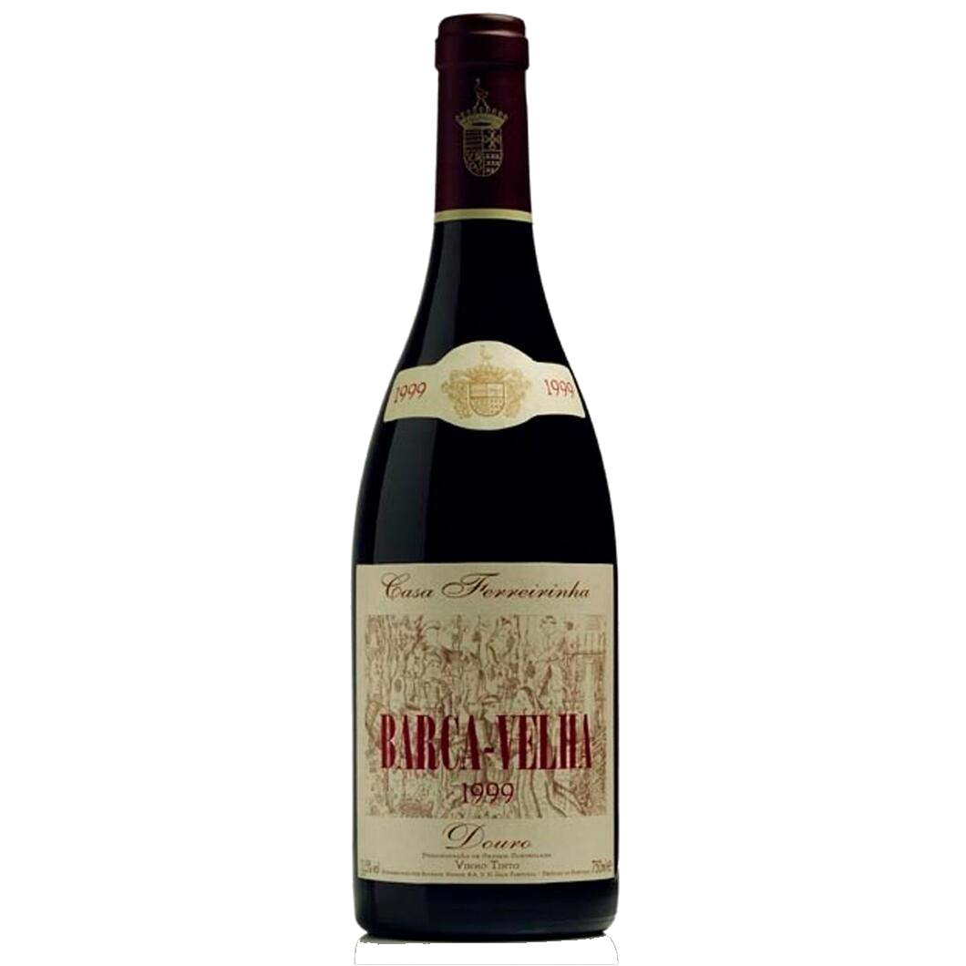
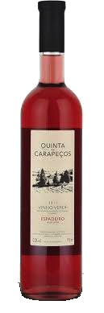
Feature Importance
Low quality
Airy
Low alcohol
High quality
Dense
Sharp acidity
Significance to Portugal
Dietary
Geographic
Historical

Slide 3
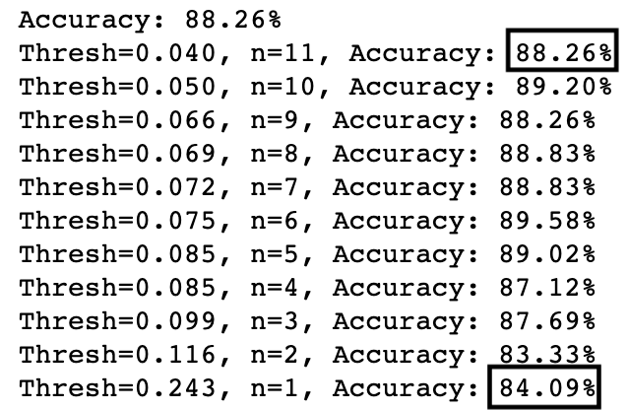
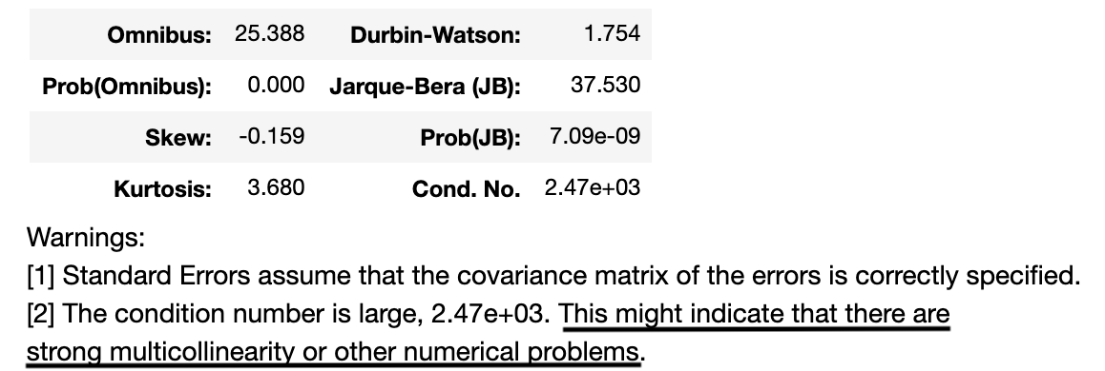
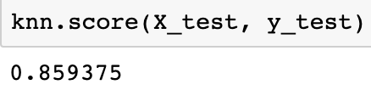
Feature Importance
Predictive application
Adequate forecasting with small number of features
Suggests high correlation between independent variables

Slide 4
Jake – Chief Oenologist
Distinct Qualification:
Proprietary process to consistently produce a high quality product
Executive Summary…
Discovery Matrix:
Identifies key relationships of core product characteristics (Qty and % Mix).
Performance Dispersion:
Identifies distribution of core product characteristics
Average Stack
Provides segmentation and scale of core product characteristics
Ranked Heat Map
Provides relationship trends
Data Driven Results Mapping
Provides recipe targets of core product characteristics
https://public.tableau.com/profile/garet.douglass#!/vizhome/WineProject_15960396866710/TargetMeasuresScatter?publish=yes

Slide 5
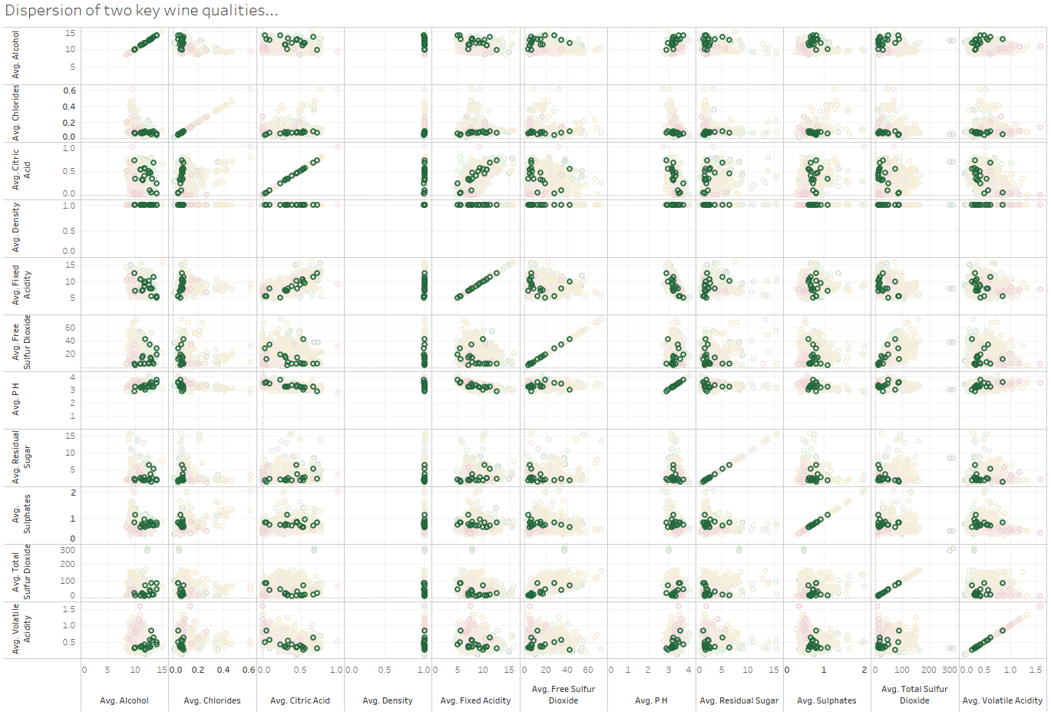
Discovery Matrix: Qty
Identify relevant relationships & correlations
Notes:
Summarize your research in three to five points.

Slide 6
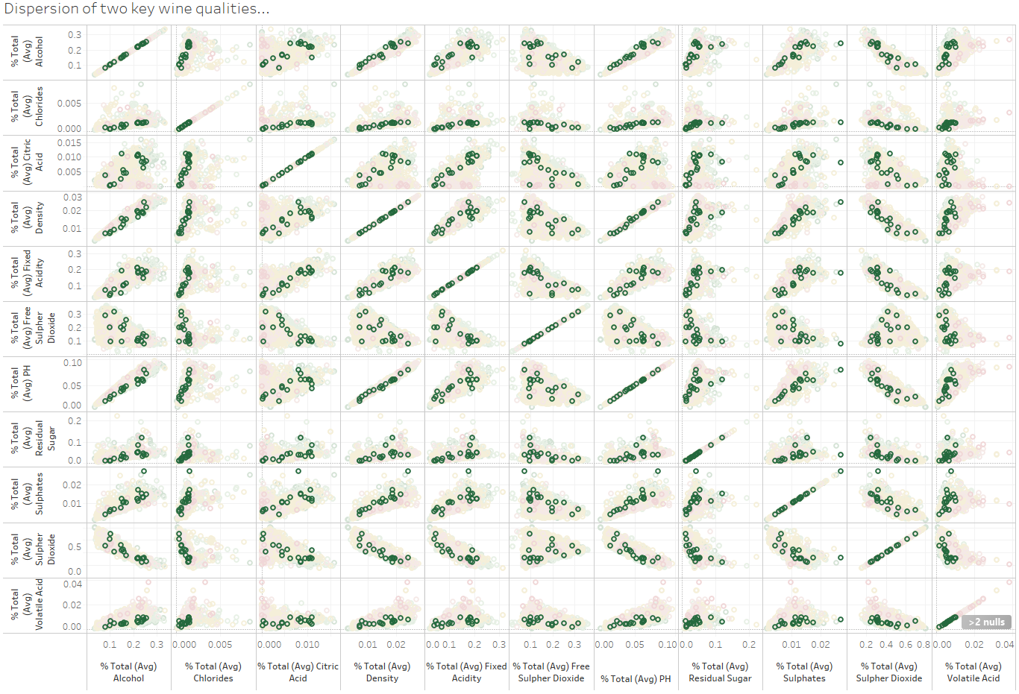
Discovery Matrix: % Mix
Notes:
Summarize your research in three to five points.

Slide 7
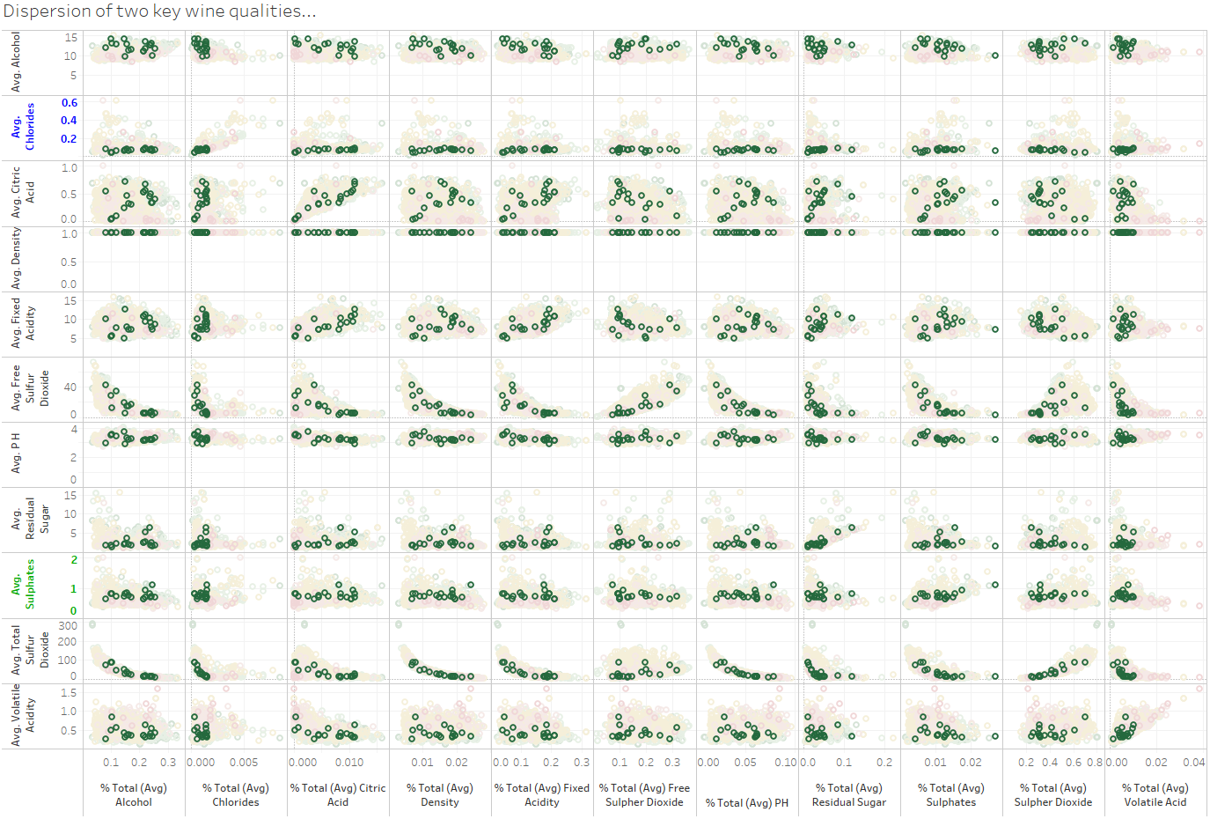
Discovery Matrix: % Mix vs. Quantity
Notes:
Summarize your research in three to five points.

Slide 8
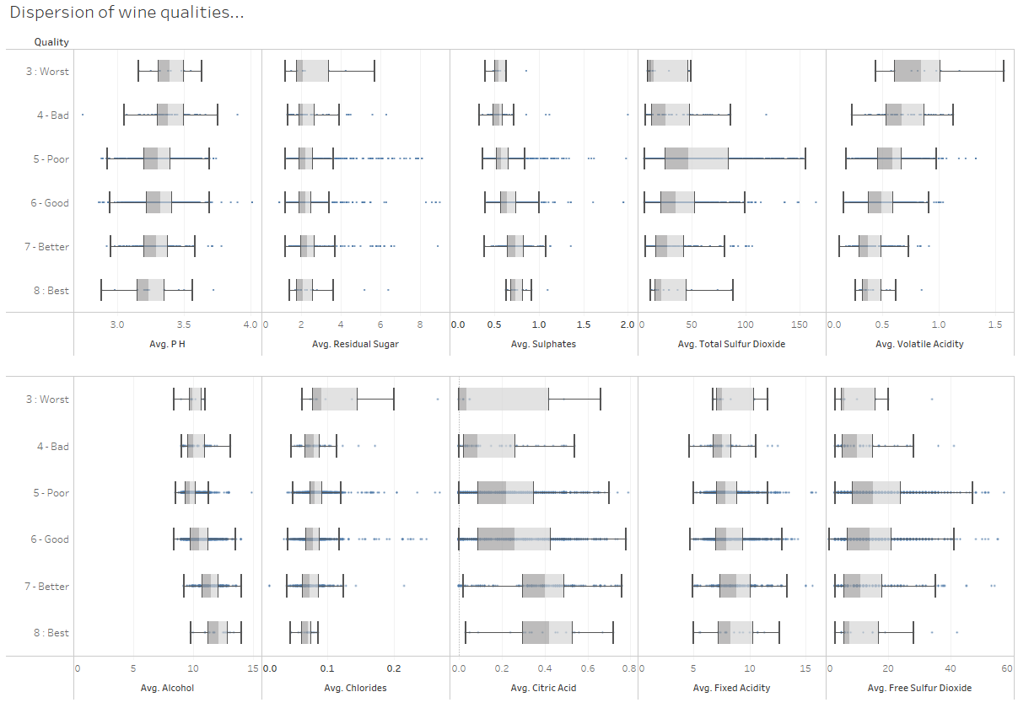
Performance Dispersion

Slide 9
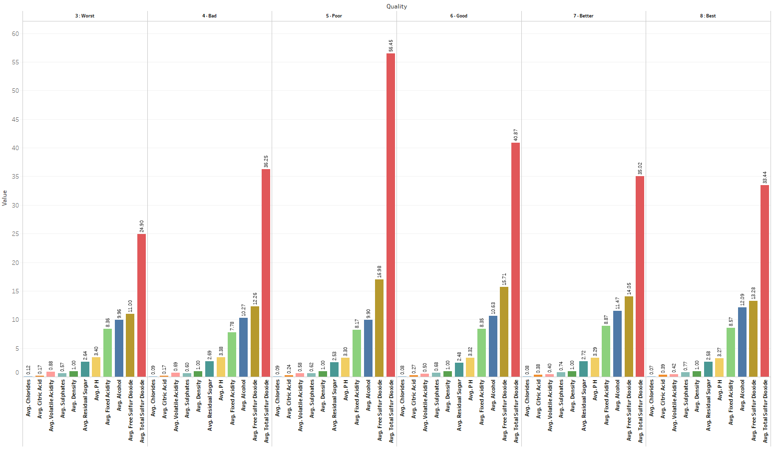
Average Stack

Slide 10
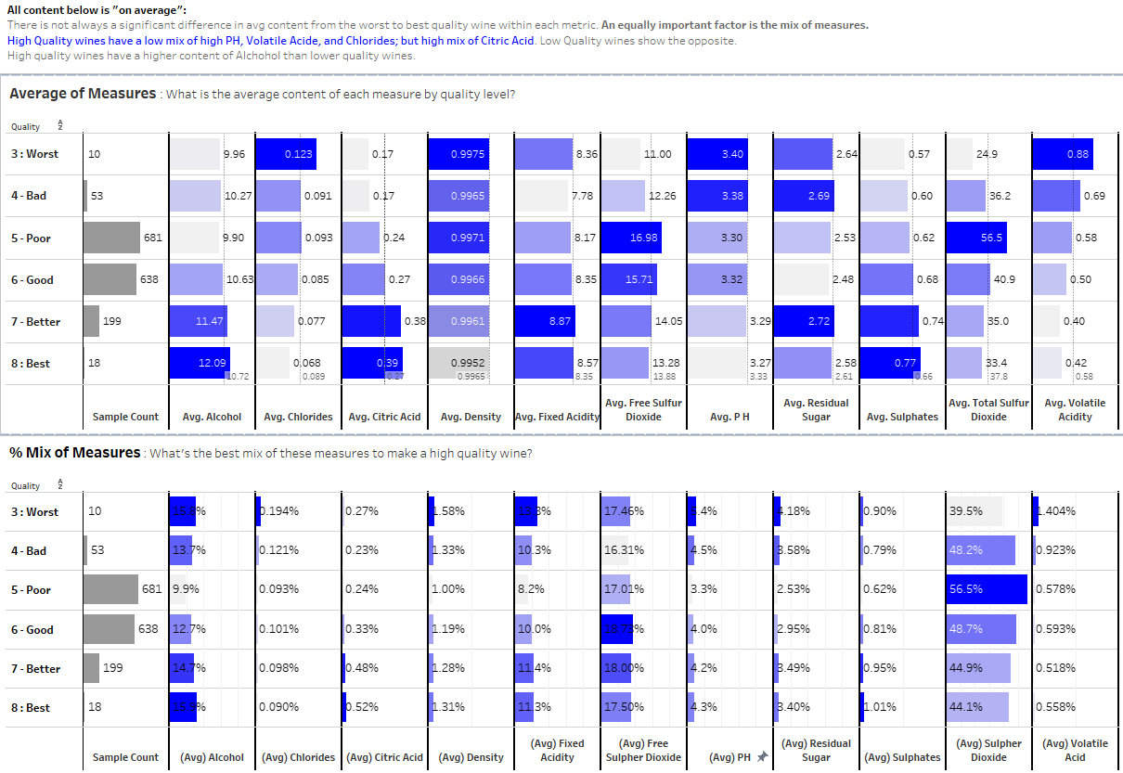
Ranked Heat Map

Slide 11
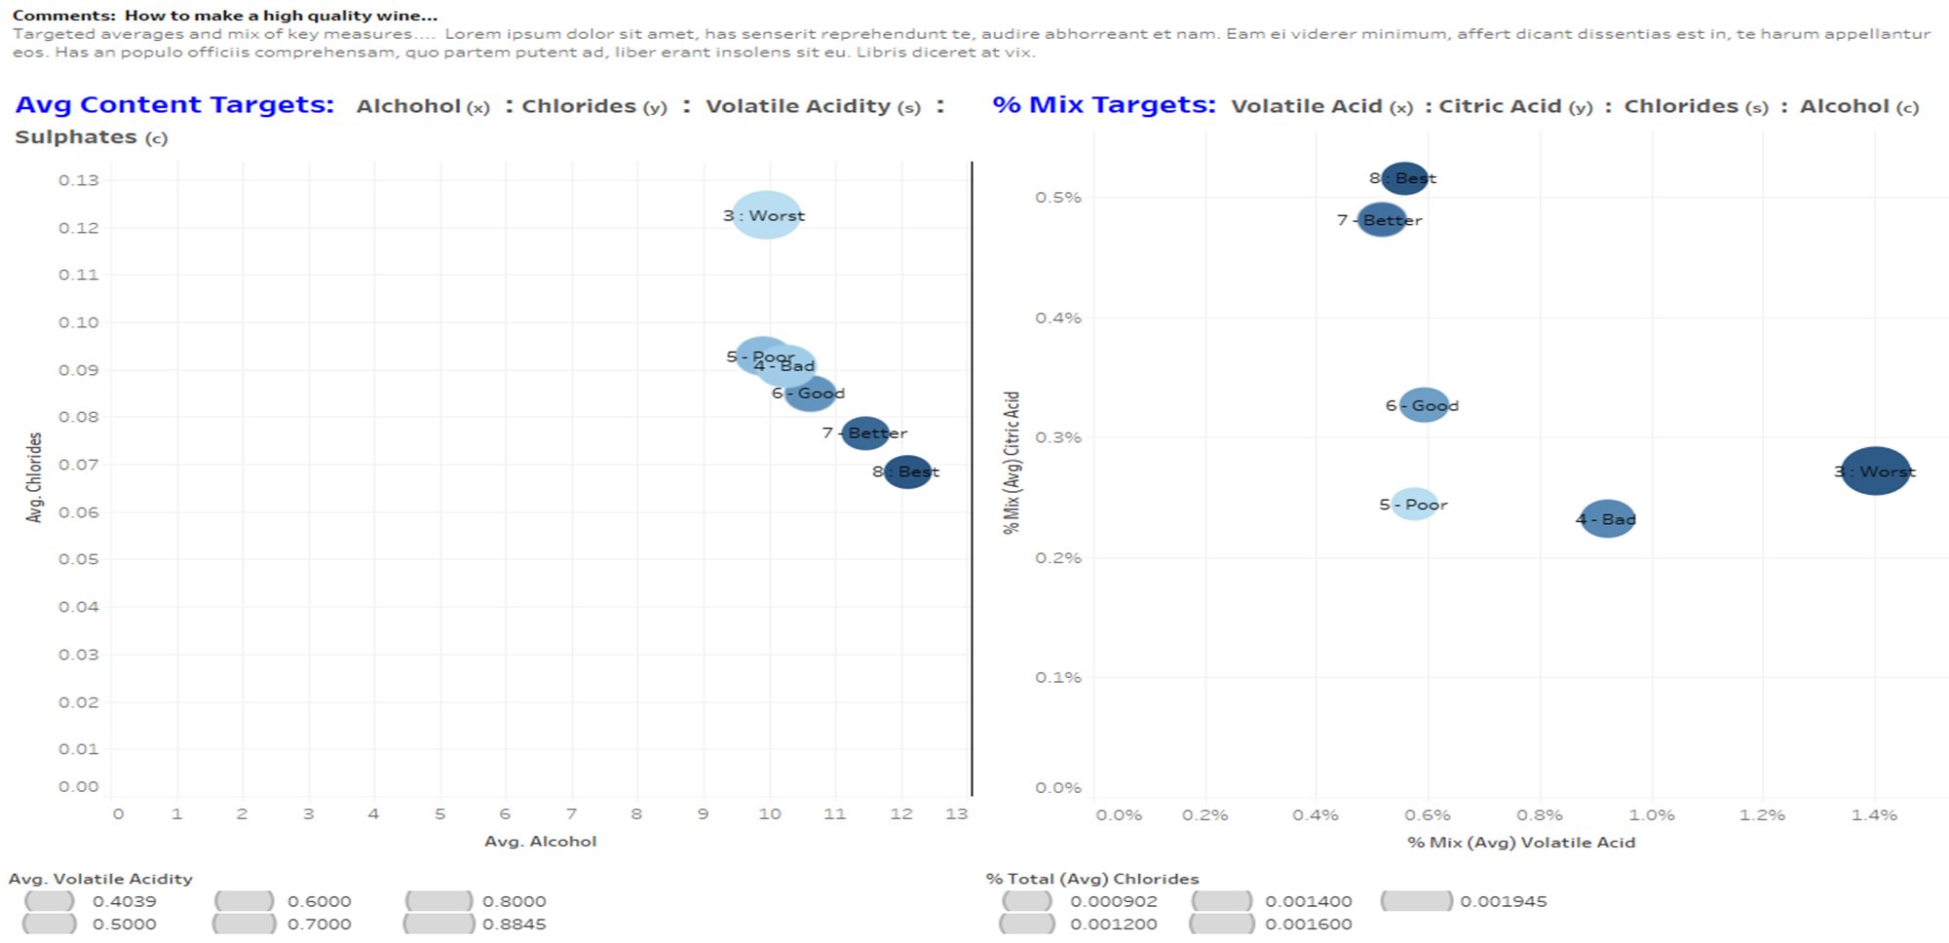
Data Driven Results Mapping: What makes a high quality wine…
Key Findings:
Content:
Alcohol
Chlorides
Volatile Acidity
Sulphates
Mix:
Volatile Acid
Citric Acid
Chlorides
Alcohol

Slide 12
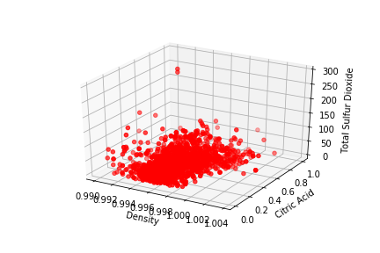
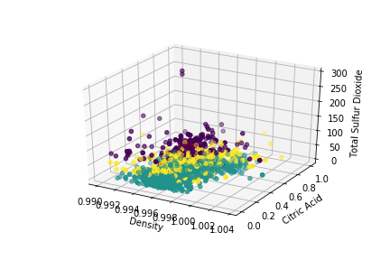
Machine Learning – Clustering Algorithm with 3 Features
Cluster | Density | Citric Acid | Total Sulfur Dioxide
Cluster 1 | 0.9969 | 0.2729 | 108.849
Cluster 2 | 0.9966 | 0.2653 | 22.911
Cluster 3 | 0.9969 | 0.2793 | 56.015

Slide 13
Machine Learning – Clustering with All Features
Cluster | Fixed Acidity | Volatile Acidity | Citric Acid | Residual Sugar | Chlorides | Free Sulfur Dioxide | Total Sulfur Dioxide | Density | pH | Sulphates | Alcohol
Cluster 1 Centroid | 8.470 | 0.5195 | 0.2686 | 2.361 | 0.0846 | 8.995 | 22.39 | 0.9966 | 3.311 | 0.6472 | 10.58
Cluster 2 Centroid | 7.888 | 0.5724 | 0.2756 | 3.232 | 0.0884 | 26.15 | 108.506 | 0.9969 | 3.290 | 0.6520 | 10.01
Cluster 3 Centroid | 8.287 | 0.5205 | 0.2724 | 2.497 | 0.0913 | 21.57 | 54.888 | 0.9969 | 3.320 | 0.677 | 10.377

Slide 14
Conclusion
Few features are required to obtain an accurate prediction of the overall quality of a wine in this region.
Many of our wine features are highly correlated with each other.
Empirically we have found that high quality wines from this region are more dense, acidic, have a higher alcohol content, and lower amount of chlorides.
Based on the cluster recognition algorithm, we propose that there are approximately 3 different “types” or brands of wine contained within this dataset.

